Slide 1
Application of supervised learning
Regression

Slide 2
Regression
For classification the output(s) is nominal
In regression the output is continuous
Function Approximation
Many models could be used – Simplest is linear regression
Fit data with the best hyper-plane which "goes through" the points
y
dependent
variable
(output)
x – independent variable (input)

Slide 3
Regression
For classification the output(s) is nominal
In regression the output is continuous
Function Approximation
Many models could be used – Simplest is linear regression
Fit data with the best hyper-plane which "goes through" the points
y
dependent
variable
(output)
x – independent variable (input)
Notes:
Show generalization

Slide 4
Regression
For classification the output(s) is nominal
In regression the output is continuous
Function Approximation
Many models could be used – Simplest is linear regression
Fit data with the best hyper-plane which "goes through" the points
For each point the differences between the predicted point and the actual observation is the residue
y
x

Slide 5
Simple Linear Regression
For now, assume just one (input) independent variable x, and one (output) dependent variable y
Multiple linear regression assumes an input vector x
Multivariate linear regression assumes an output vector y
We will "fit" the points with a line (i.e. hyper-plane)
Which line should we use?
Choose an objective function
For simple linear regression we choose sum squared error (SSE)
Σ (predicted_{i} – actual_{i})² = Σ (residue_{i})²
Thus, find the line which minimizes the sum of the squared residues (e.g. least squares)
Notes:
Hyperplane for multiple linear regression

Slide 6
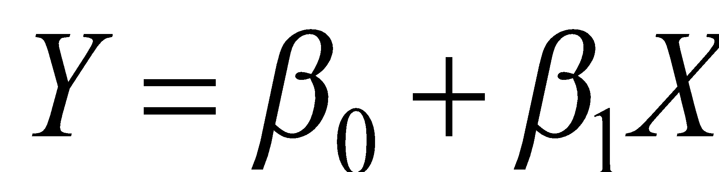
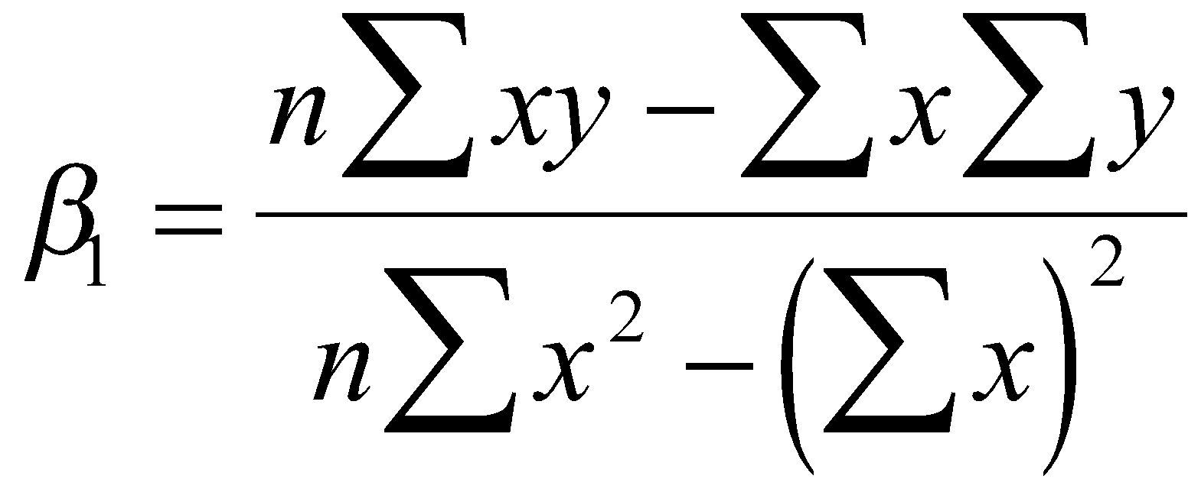
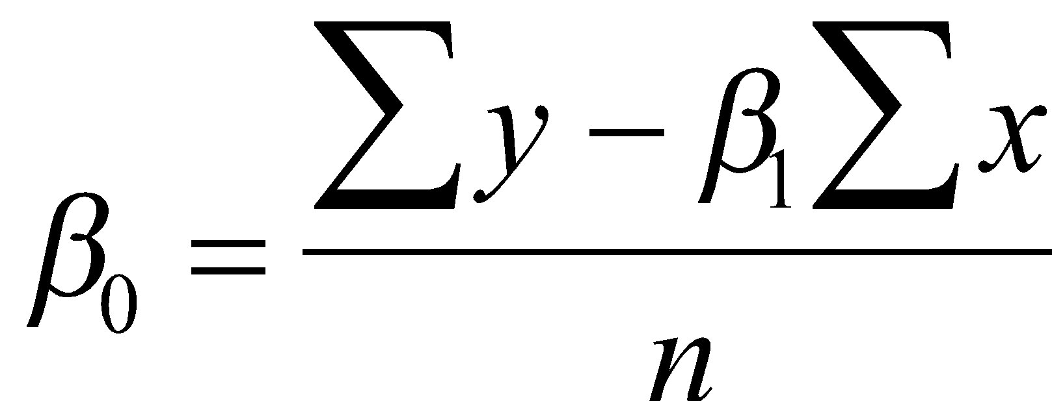
How do we "learn" parameters
For the 2-d problem (line) there are coefficients for the bias and the independent variable (y-intercept and slope)
To find the values for the coefficients which minimize the objective function we take the partial derivates of the objective function (SSE) with respect to the coefficients. Set these to 0, and solve.

Slide 7
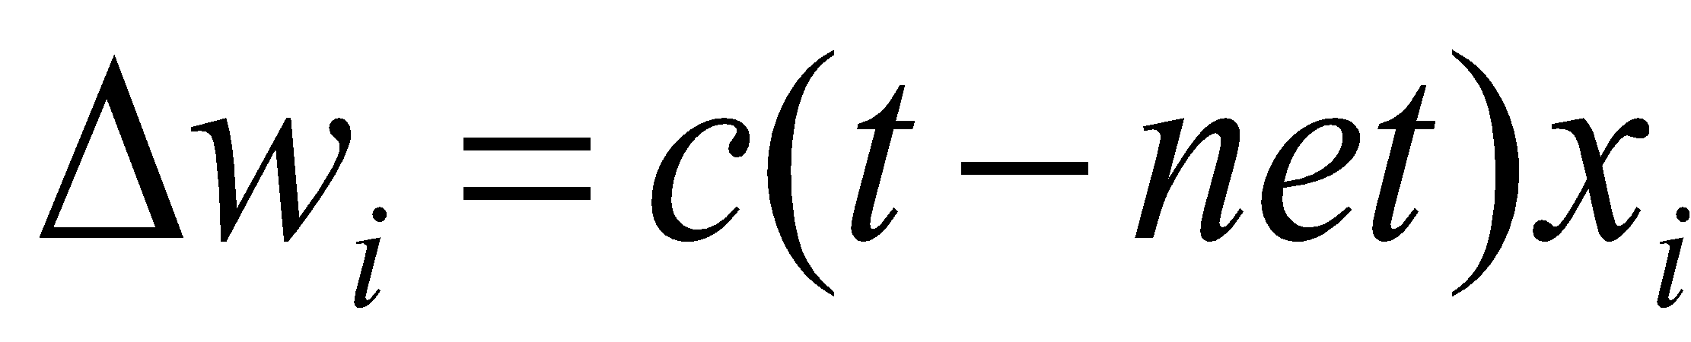
Multiple Linear Regression
There is a closed form for finding multiple linear regression weights which requires matrix inversion, etc.
There are also iterative techniques to find weights
One is the delta rule. For regression we use an output node which is not thresholded (just does a linear sum) and iteratively apply the delta rule – thus the net is the output
Where c is the learning rate and x is input for that weight
Delta rule will update towards the objective of minimizing the SSE, thus solving multiple linear regression
There are many other regression approaches that give different results by trying to better handle outliers and other statistical anomalies
Notes:
Note target really is the point being regressed to each time. Now makes better sense since net is the output and we want to minimize error of the target.

Slide 8
Intelligibility
One nice advantage of linear regression models (and linear classification) is the potential to look at the coefficients to give insight into which input variables are most important in predicting the output
The variables with the largest magnitude have the highest correlation with the output
A large positive coefficient implies that the output will increase when this input is increased (positively correlated)
A large negative coefficient implies that the output will decrease when this input is increased (negatively correlated)
A small or 0 coefficient suggests that the input is uncorrelated with the output (at least at the 1st order)
Linear regression can be used to find best "indicators"
However, be careful not to confuse correlation with causality
Notes:
Dependent (output) variable rain. Independent (input) variable: Clouds, umbrella open, etc. Open-Umbrella is correlate, not causal.

Slide 9
SSE and Linear Regression
SSE chooses to square the difference of the predicted vs actual. Why square?
Don't want residues to cancel each other
Could use absolute or other distances to solve problem
Σ |predicted_{i} – actual_{i}| : L1 vs L2
SSE leads to a parabolic error surface which is good for gradient descent
Which line would least squares choose?
There is always one “best” fit
Notes:
Would choose middel 9+9 < 49

Slide 10
SSE and Linear Regression
SSE chooses to square the difference of the predicted vs actual. Why square?
Don't want residues to cancel each other
Could use absolute or other distances to solve problem
Σ |predicted_{i} – actual_{i}| :
SSE leads to a parabolic error surface which is good for gradient descent
Which line would least squares choose?
There is always one “best” fit
7
Notes:
Show error for each line. 49

Slide 11
SSE and Linear Regression
SSE chooses to square the difference of the predicted vs actual. Why square?
Don't want residues to cancel each other
Could use absolute or other distances to solve problem
Σ |predicted_{i} – actual_{i}| :
SSE leads to a parabolic error surface which is good for gradient descent
Which line would least squares choose?
There is always one “best” fit
7
5
Notes:
Would choose middel 9+9 < 49

Slide 12
SSE and Linear Regression
SSE chooses to square the difference of the predicted vs actual. Why square?
Don't want residues to cancel each other
Could use absolute or other distances to solve problem
Σ |predicted_{i} – actual_{i}| :
SSE leads to a parabolic error surface which is good for gradient descent
Which line would least squares choose?
There is always one “best” fit
Note that the squared error causes the model to be more highly influenced by outliers
Though best fit assuming Gaussian noise error from true surface
7
3
5
3
Notes:
Would choose middel 9+9 < 49
NOW TRY absolute value, less good results, multiple tied best lines, etc.

Slide 13
SSE and Linear Regression Generalization
In generalization all x values map to a y value on the chosen regression line
7
5
3
3
y – Input Value
1
0 1 2 3
x – Input Value
Notes:
Would choose middel 9+9 < 49
NOW TRY absolute value, less good results, multiple tied best lines, etc.

Slide 14
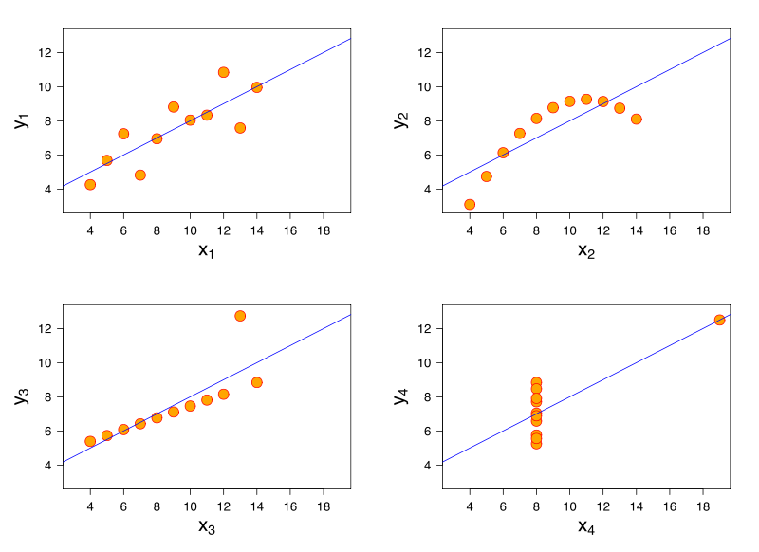
Anscombe's Quartet
What lines "really" best fit each case? – different approaches
Notes:
Standard LR gives same line for each
If Gaussian error is #4 likely?, But in actual data set with human error, etc.?
Some approaches fit bottom two, but which is best? Noise vs exception

Slide 15
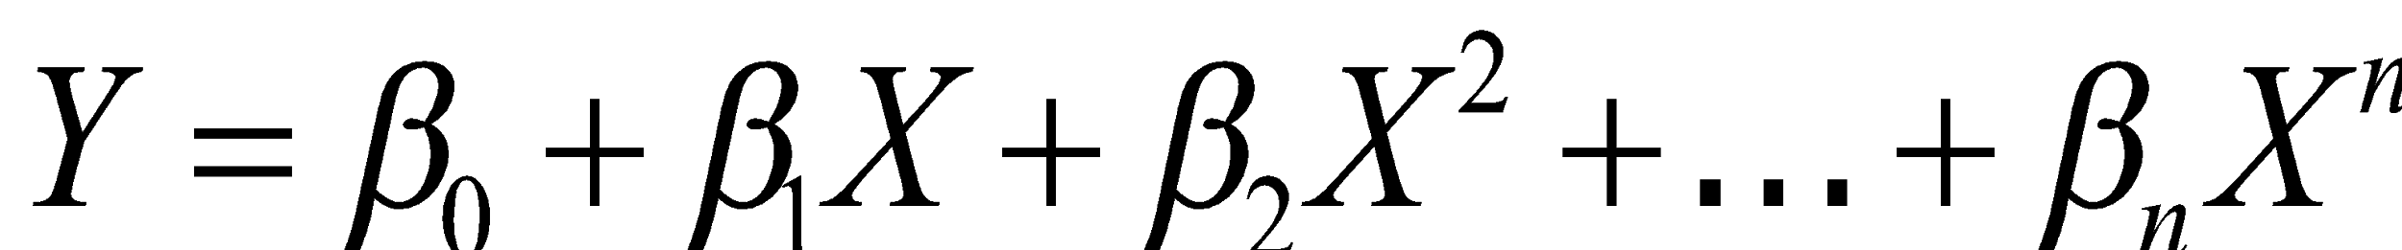
Non-Linear Tasks
Linear Regression will not generalize well to the task below
Needs a non-linear surface
Could do a feature pre-process as with the quadric machine
For example, we could use an arbitrary polynomial in x
Thus it is still linear in the coefficients, and can be solved with delta rule, etc.
What order polynomial should we use? – Overfit issues occur as we'll discuss later

Slide 16
Delta rule natural for regression, not classification
First consider the one dimensional case
The decision surface for the perceptron would be any (first) point that divides instances
Delta rule will try to fit a line through the target values which minimizes SSE and the decision point will be where the line crosses .5 for 0/1 targets. Looking down on data for perceptron view. Now flip it on its side for delta rule view.
Will converge to the one optimal line (and dividing point) for this objective
x
1
z
0
x
Notes:
looking down on data for perceptron view. Now flip it on its side for delta rule view

Slide 17
Delta Rule for Classification?
1
z
0
x
1
z
0
x
What would happen in this adjusted case for perceptron and delta rule and where would the decision point (i.e. .5 crossing) be?

Slide 18
Delta Rule for Classification?
1
z
0
x
1
z
0
x
Leads to misclassifications even though the data is linearly separable
For Delta rule the objective function is to minimize the regression line SSE, not maximize classification

Slide 19
Delta Rule for Classification?
1
z
0
x
1
z
0
x
1
z
0
x
What would happen if we were doing a regression fit with a sigmoid/logistic curve rather than a line?

Slide 20
Delta Rule for Classification?
1
z
0
x
1
z
0
x
1
z
0
x
Sigmoid fits many decision cases quite well! This is basically what logistic regression does.

Slide 21
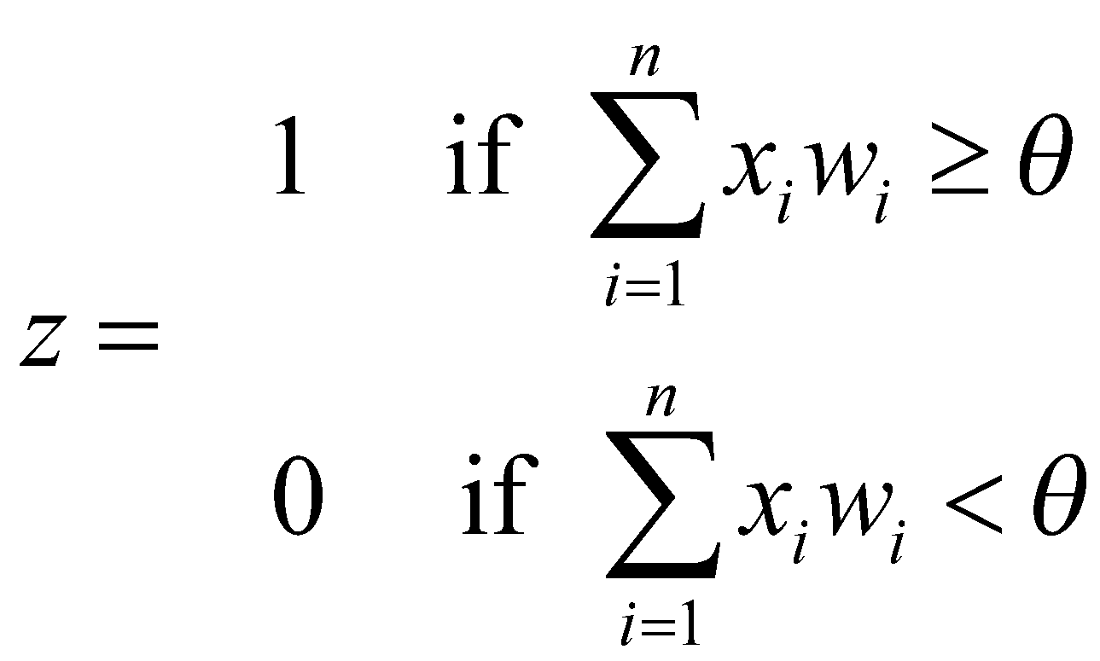
Observation: Consider the 2 input perceptron case without a bias weight. Note that the output z is a function of 2 input variables for the 2 input case (x₁, x₂), and thus we really have a 3-d decision surface (i.e. a plane accounting for the two input variables and the 3rd dimension for the output), yet the decision boundary is still a line in the 2-d input space when we represent the outputs with different colors, symbols, etc. The Delta rule would fit a regression plane to these points with the decision line being that line where the plane went through .5. What would logistic regression do?
1
0
Notes:
Logistic Regression will put a 3-d sigmoidal to fit the points with the decision boundary being the line going through the .5 of the sigmoidal – skip?

Slide 22
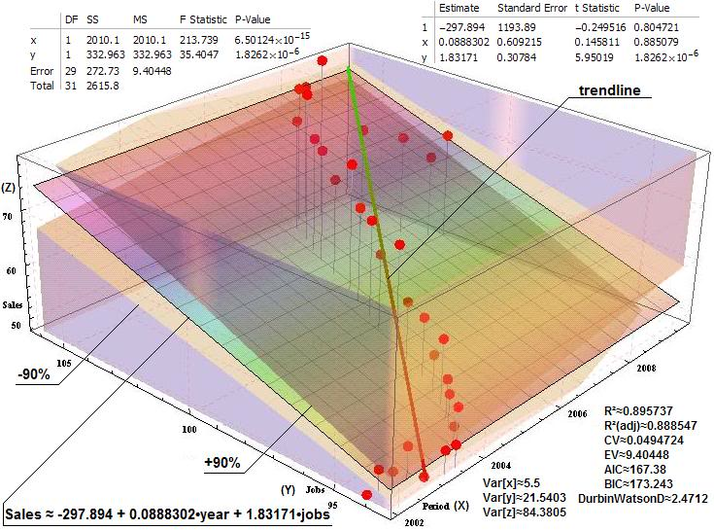

Slide 23
Linear Regression Homework
Assume we start with all weights as 0 (don’t forget the bias)
Remember for regression we use an output node which is not thresholded (just does a linear sum) and iteratively apply the delta rule – thus the net is the output
What are the new weights after one iteration through the following training set using the delta rule with a learning rate c = .2
x | y | Target
.3 | .8 | .7
-.3 | 1.6 | -.1
.9 | 0 | 1.3

Slide 24
Logistic Regression
One commonly used algorithm is Logistic Regression
Assumes that the dependent (output) variable is binary which is often the case in medical and other studies. (Does person have disease or not, survive or not, accepted or not, etc.)
Like Quadric, Logistic Regression does a particular non-linear transform on the data after which it just does linear regression on the transformed data
Logistic regression fits the data with a sigmoidal/logistic curve rather than a line and outputs an approximation of the probability of the output given the input

Slide 25
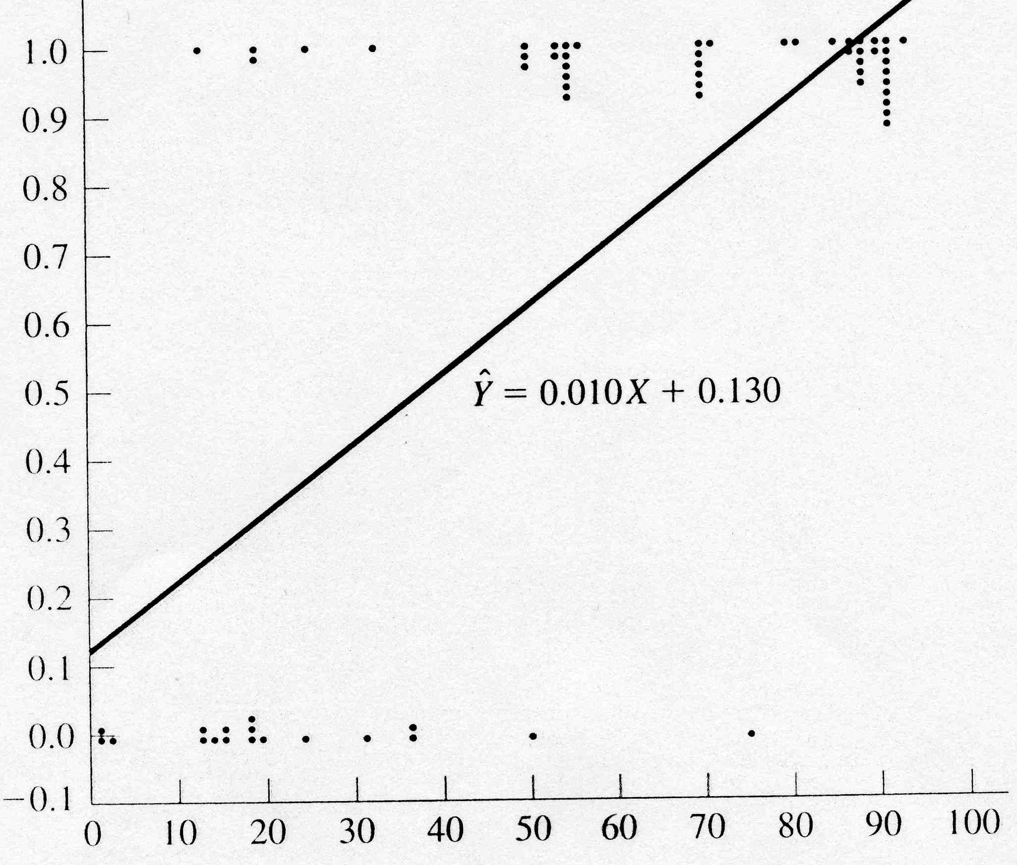
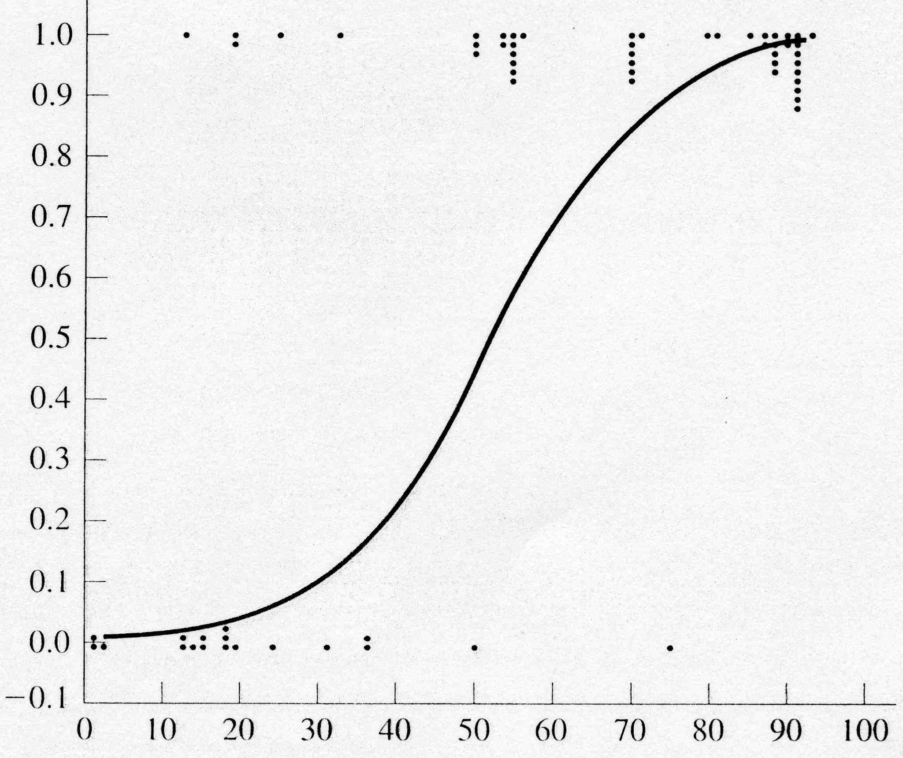
Logistic Regression Example
Age (X axis, input variable) – Data is fictional
Heart Failure (Y axis, 1 or 0, output variable)
Could use value of regression line as a probability approximation
Extrapolates outside 0-1 and not as good empirically
Sigmoidal curve to the right gives empirically good probability approximation and is bounded between 0 and 1

Slide 26
Logistic Regression Approach
Learning
Transform initial input probabilities into log odds (logit)
Do a standard linear regression on the logit values
This effectively fits a logistic curve to the data, while still just doing a linear regression with the transformed input (ala quadric machine, etc.)
Generalization
Find the value for the new input on the logit line
Transform that logit value back into a probability

Slide 27
Non-Linear Pre-Process to Logit (Log Odds)
Medication Dosage | # Cured | Total Patients | Probability: # Cured/Total Patients
20 | 1 | 5 | .20
30 | 2 | 6 | .33
40 | 4 | 6 | .67
50 | 6 | 7 | .86
Cured
1
prob.
Cured
Not Cured
0
0 10 20 30 40 50 60
0 10 20 30 40 50 60
Notes:
If just 1/0 we would divide at about 35
Go to next slide after probability column and then come back

Slide 28
Non-Linear Pre-Process to Logit (Log Odds)
Medication Dosage | # Cured | Total Patients | Probability: # Cured/Total Patients
20 | 1 | 5 | .20
30 | 2 | 6 | .33
40 | 4 | 6 | .67
50 | 6 | 7 | .86
Cured
1
prob.
Cured
Not Cured
0
0 10 20 30 40 50 60
0 10 20 30 40 50 60
Notes:
If just 1/0 we would divide at about 35
Go to next slide after probability column and then come back

Slide 29
Logistic Regression Approach
Could use linear regression with the probability points, but that would not extrapolate well
Logistic version is better but how do we get it?
Similar to Quadric we do a non-linear pre-process of the input and then do linear regression on the transformed values – do a linear regression on the log odds - Logit
1
1
prob.
Cured
prob.
Cured
0
0
0 10 20 30 40 50 60
0 10 20 30 40 50 60

Slide 30
Non-Linear Pre-Process to Logit (Log Odds)
Medication Dosage | # Cured | Total Patients | Probability: # Cured/Total Patients | Odds: p/(1-p) = # cured/ # not cured | Logit Log Odds: ln(Odds)
20 | 1 | 5 | .20 | .25 | -1.39
30 | 2 | 6 | .33 | .50 | -0.69
40 | 4 | 6 | .67 | 2.0 | 0.69
50 | 6 | 7 | .86 | 6.0 | 1.79
Cured
1
prob.
Cured
Not Cured
0
0 10 20 30 40 50 60
0 10 20 30 40 50 60
Notes:
explain odds with the 40 dosage – ration of wins/losses
mid sigmoid runs through .5 prob = 0 logit = ln(1)

Slide 31
Regression of Log Odds
Medication Dosage | # Cured | Total Patients | Probability: # Cured/Total Patients | Odds: p/(1-p) = # cured/ # not cured | Log Odds: ln(Odds)
20 | 1 | 5 | .20 | .25 | -1.39
30 | 2 | 6 | .33 | .50 | -0.69
40 | 4 | 6 | .67 | 2.0 | 0.69
50 | 6 | 7 | .86 | 6.0 | 1.79
+2
0
-2
0 10 20 30 40 50 60
1
prob.
Cured
0
y = .11x – 3.8 - Logit regression equation
Now we have a regression line for log odds (logit)
To generalize, we interpolate the log odds value for the new data point
Then we transform that log odds point to a probability: p = e^{logit(x)}/(1+e^{logit(x)})
For example assume we want p for dosage = 10
Logit(10) = .11(10) – 3.8 = -2.7
p(10) = e^{-2.7}/(1+e^{-2.7}) = .06 [note that we just work backwards from logit to p]
These p values make up the sigmoidal regression curve (which we never have to actually plot)
Notes:
yellow point is a generalization example

Slide 32
Summary
Linear Regression and Logistic Regression are nice tools for many simple situations
But both force us to fit the data with one shape (line or sigmoid) which will often underfit
Intelligible results
When problem includes more arbitrary non-linearity then we need more powerful models which we will introduce
Though non-linear data transformation can help in these cases while still using a linear model for learning
These models are commonly used in data mining applications and also as a "first attempt" at understanding data trends, indicators, etc.

Slide 33
Logistic Regression Homework
You don’t actually have to come up with the weights for this one, though you could do so quickly by using the closed form linear regression approach
Sketch each step you would need to learn the weights for the following data set using logistic regression
Sketch how you would generalize the probability of a heart attack given a new input heart rate of 60
Heart Rate | Heart Attack
50 | Y
50 | N
50 | N
50 | N
70 | N
70 | Y
90 | Y
90 | Y
90 | N
90 | Y
90 | Y

